Slide 1


Deep Interval Neural Network in Computational Solid Mechanics
By: David Betancourt, PhD Student CSE-CEE
and Rafi Muhanna
Reliable Engineering Computing - Georgia Tech

Slide 2
Presentation Outline
Problem Background
Computational Solid Mechanics in Civil Engineering
FEM
Uncertainty in FEM inputs
Interval Uncertainty
Interval Fields
Deep Interval Neural Network

Slide 3
Background

Slide 4
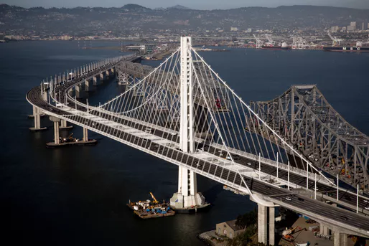
Computational Solid Mechanics in Civil Engineering
The system consists of a structure or domain that undergoes some applied stress or vibration.
Photo credit: Archinect
Notes:
Picture caption: A 2,500% budget overrun: the story of the Bay Bridge's dramatic cost inflation from $250M to $6.5B
https://archinect.com/news/article/139035988/a-2-500-budget-overrun-the-story-of-the-bay-bridge-s-dramatic-cost-inflation-from-250m-to-6-5b

Slide 5
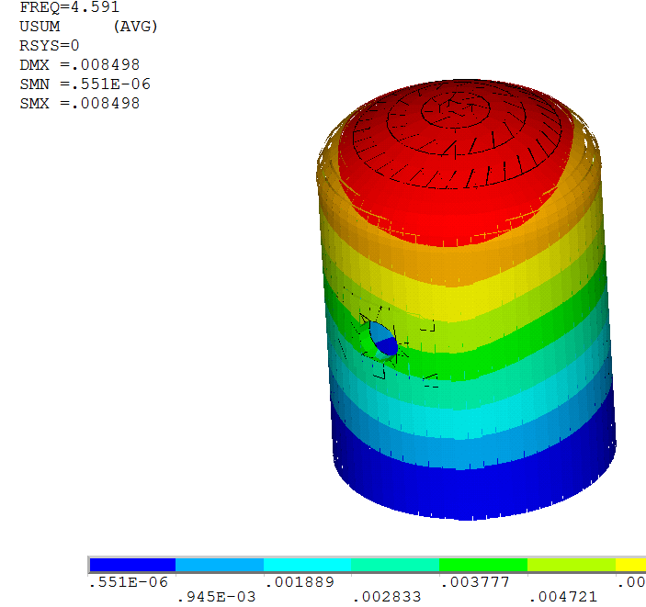
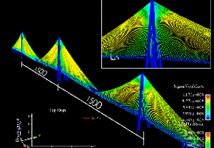
Computational Solid Mechanics in Civil Engineering
The finite element method (FEM) is typically used in computational solid mechanics to find the system’s response.
Notes:
Picture caption: A 2,500% budget overrun: the story of the Bay Bridge's dramatic cost inflation from $250M to $6.5B
https://archinect.com/news/article/139035988/a-2-500-budget-overrun-the-story-of-the-bay-bridge-s-dramatic-cost-inflation-from-250m-to-6-5b

Slide 6
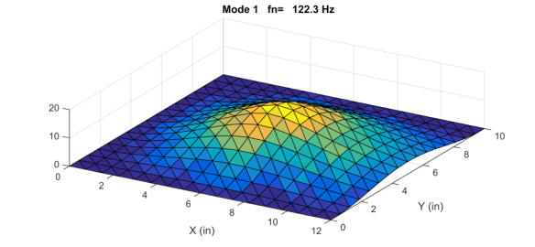
FEM input and outputs
Inputs:
Material properties
Support conditions
Applied pressure
Outputs:
Displacements
Stresses
Vibration frequencies
FE Mesh
Notes:
Picture caption: A 2,500% budget overrun: the story of the Bay Bridge's dramatic cost inflation from $250M to $6.5B
https://archinect.com/news/article/139035988/a-2-500-budget-overrun-the-story-of-the-bay-bridge-s-dramatic-cost-inflation-from-250m-to-6-5b

Slide 7
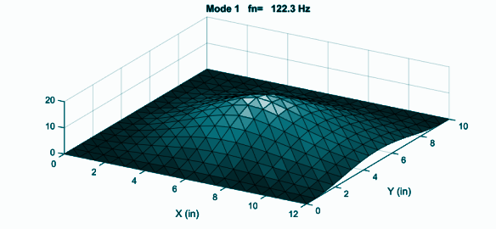
The research problem: Quantifying spatiotemporal uncertainty in systems inputs
Many times in civil engineering we lack enough knowledge about the system inputs.
Variation of applied pressure is uncertain
Variation of material properties is uncertain
Variation of support conditions is uncertain

Slide 8
Uncertainty in civil engineering systems
Not modeling uncertainty properly can lead to:
Catastrophic events.
Inaccurate expectations of systems performance.
Increased engineering schedules and costs.
In the context of computational mechanics:
Uncertainty can be spatially-varying and/or temporally varying.
Loadings, materials, boundary conditions.

Slide 9
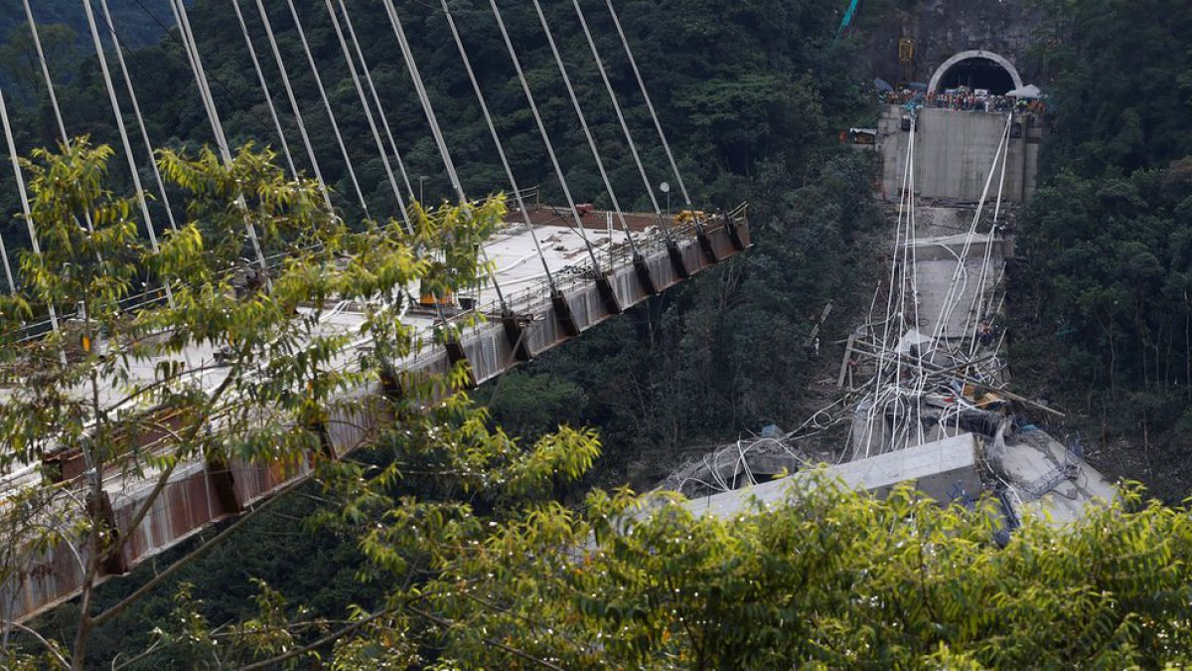

Uncertainty in civil engineering systems
Notes:
https://www.youtube.com/watch?v=q-Vbe4ZqRak bridge collapse colombia

Slide 10
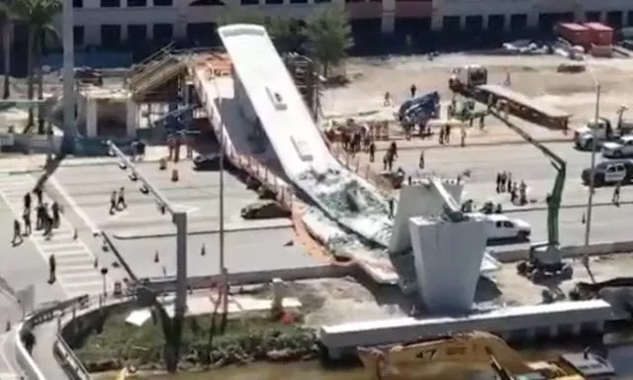
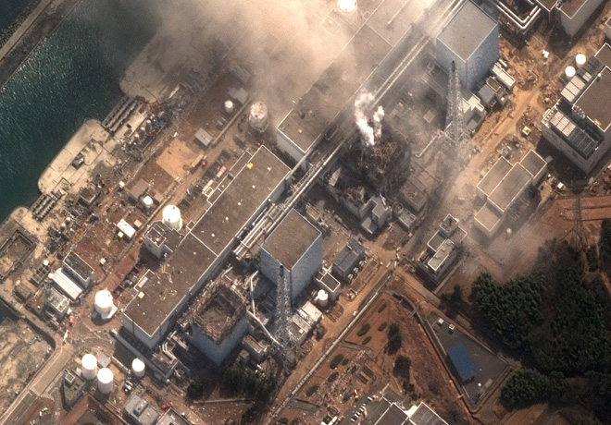
Uncertainty in civil engineering systems
Notes:
https://www.youtube.com/watch?v=q-Vbe4ZqRak bridge collapse colombia

Slide 11
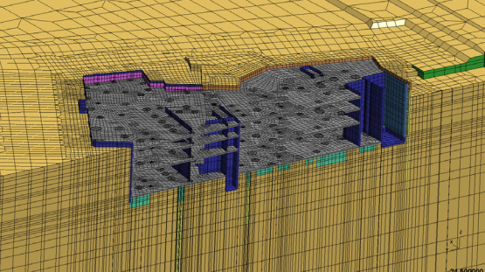
Uncertainty in civil engineering systems (SFEM)
In computational mechanics:
Uncertainty is commonly modeled with with random field theory within the Stochastic Finite Element method (SFEM).
SFEM makes assumptions about the probability distribution of the uncertainty, usually Gaussian.

Slide 12
Uncertainty in engineering systems (SFEM vs IFEM)
In computational mechanics:
When we don’t have enough data to select a probability distribution → SFEM is inadequate. Is the world Gaussian?
Interval Finite Element method (IFEM) is an alternative.
Efficient algorithms by Muhanna & Mullen.
The IFEM:
Does not make assumptions about probability distributions (only UB and LB)
Can model epistemic and aleatory uncertainty.
BUT the IFEM:
Does not have an “interval field” that can model spatiotemporal-varying uncertainty as is the case with SFEM.

Slide 13
IFEM Process
Obtain the Response
Obtain primary responses: displacements, stresses, modes of vibrations.
Obtain secondary responses: moments, failure modes.
3
IFEM
Discretize the structure, perform interval finite element analysis to find the structural responses with interval enclosure.
2
Quantify Input Uncertainty
Model the spatiotemporal variation of the system input.
1

Slide 14
Interval Field

Slide 15
Supervised Interval Field
IFEM:
Does not have a unified interval field framework that can model spatiotemporal-varying uncertainty in the model input as in the case with SFEM.
Solution:
Use deep neural network to infer the uncertain properties in the field from indirect measurements:
Called: “Supervised Interval Field”
Works for any domain dimension (1D, 2D, 3D).
Independent of IFEM mesh discretization.

Slide 16
Prior Research: Quantify Input Variability
Obtain the Response
Obtain primary responses: displacements, stresses, modes of vibrations.
Obtain secondary responses: moments, failure modes.
3
IFEM
Discretize the structure, perform interval finite element analysis to find the structural responses with interval enclosure.
2
Quantify Input Uncertainty
Model the spatiotemporal variation of the system input.
1

Slide 17
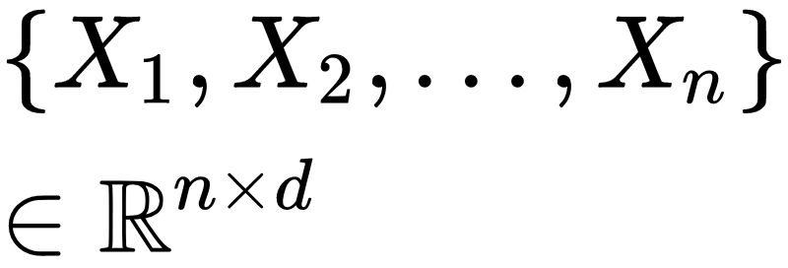
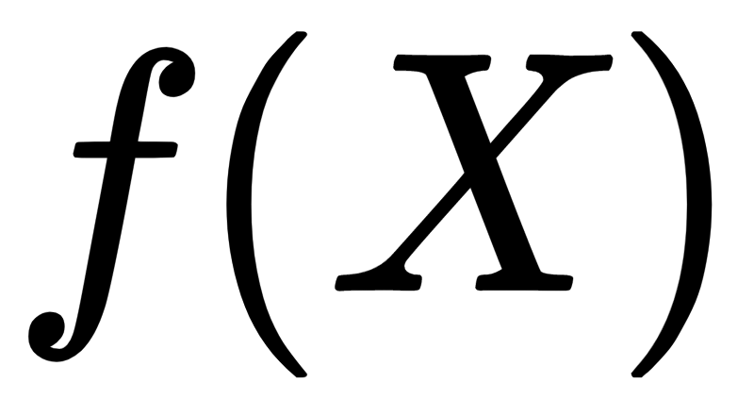
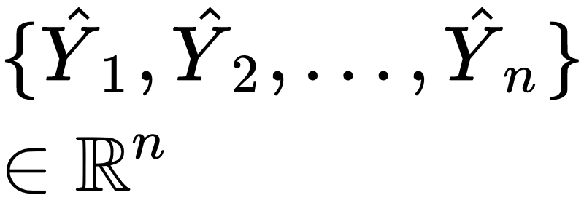
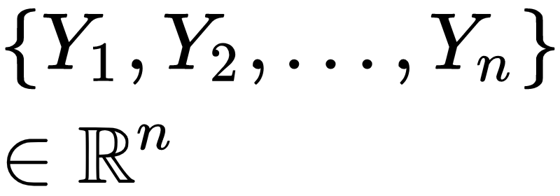
Prior Research: Quantify Input Variability
Quantifying the variability of a property Y using observations X.
Supervised Interval Field (SIF)
e.g. spatially-varying material properties
Neural Network
Estimates
Measurements
IFEM
True
Targets

Slide 18
Supervised Learning
Supervised Learning:
Train/Fit model f : X → Y.
After model is trained:
Make predictions on unseen data.
Goal of Supervised Learning:
Not overfit.
Generalize to unseen data.

Slide 19
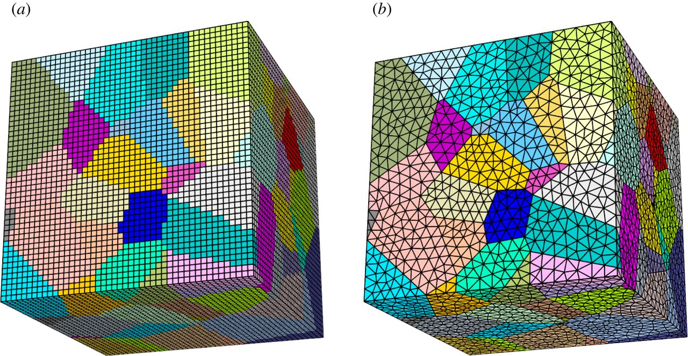

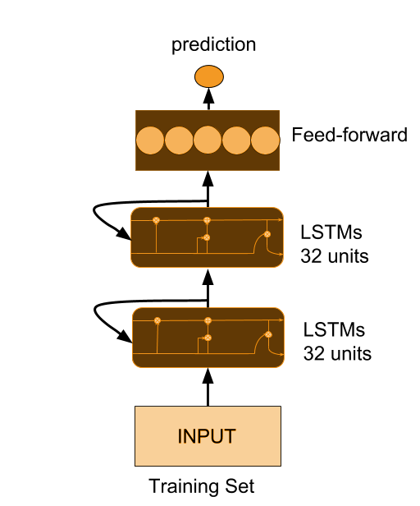
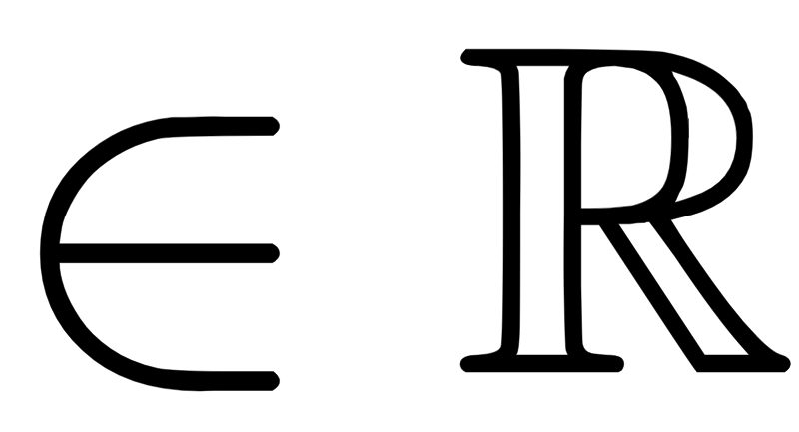
SIF-IFEM a unified framework (DON’T NEED)
SIF provides to the IFEM the uncertain property with respect to the model’s mesh.
SIF is independent of mesh, therefore, must discretize and map into IFEM mesh.
Mid-point interval value from SIF prediction assigned to each FE in the mesh.
Average of the prediction taken over the size of FE.
Add Interval Uncertainty

Slide 20
Deep Interval Neural Network

Slide 21
Deep Interval Neural Network
Problem with real-valued neural network:
Not able to propagate interval-valued inputs nor make interval-valued predictions.
Solution:
Deep Interval Neural Network using Gradient-Based Optimization
Developed by David Betancourt and Dr. Rafi Muhanna.

Slide 22
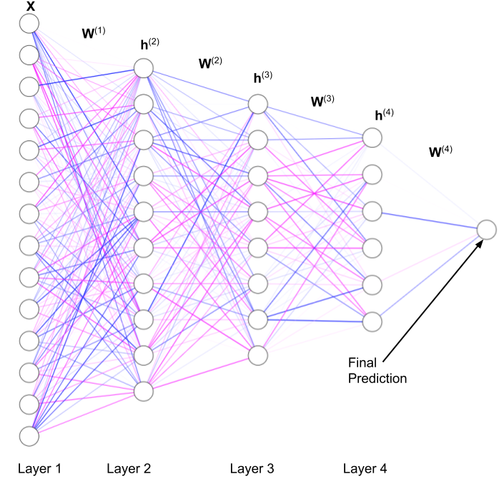
Deep Interval Neural Network (DINN)
The problem (computational mechanics):
Need to model input uncertainty to IFEM.
e.g. space-varying material properties.
Solution:
DINN takes interval matrices as input and outputs interval predictions in a regression setting to form the interval field.

Slide 23
DINN: Quantify Input Variability and Uncertainty
Obtain the Response
Obtain primary responses: displacements, stresses, modes of vibrations.
Obtain secondary responses: moments, failure modes.
3
IFEM
Discretize the structure, perform interval finite element analysis to find the structural responses with interval enclosure.
2
Quantify Input Uncertainty
Model the spatiotemporal variation of the system input.
1

Slide 24


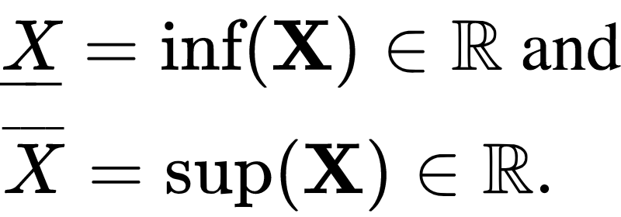
Intervals Definition
Let be the set of interval real numbers. Interval real numbers are a closed and bounded set of real numbers, s.t. if is an interval, its endpoints are

Slide 25
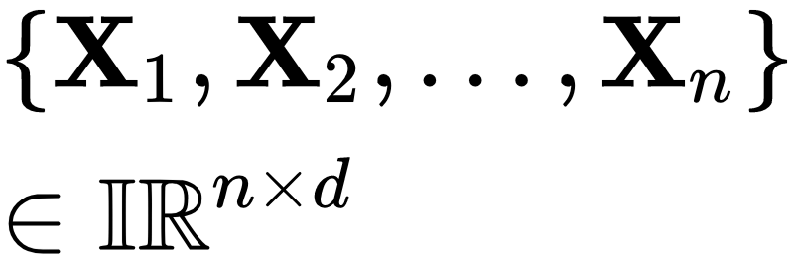
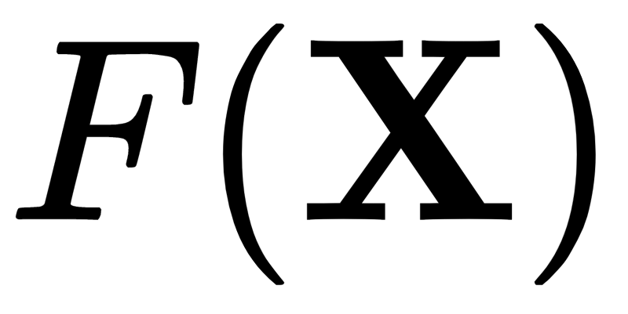
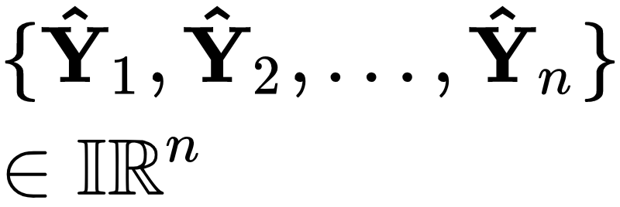
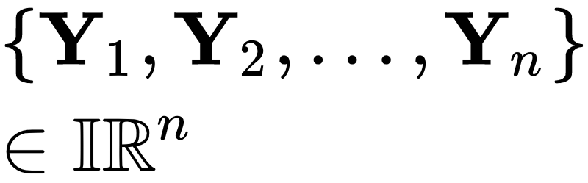
Current Research: Quantify Input Variability and Uncertainty
Quantifying the variability of a property Y using observations X, considering interval uncertainty in X.
e.g. spatially-varying material properties
X = [LB, UB]
Neural Network
Estimates
Measurements
IFEM
True
Targets
Y = [LB, UB]

Slide 26
Computational Aspects
Part II

Slide 27
What is the challenge with interval matrices in neural networks?
For NN → Need a well-behaved loss function (Lipschitz continuous).
For Intervals → Need to reduce interval dependency.
Interval enclosure gets too wide when we have repeated expressions.
E.g. X X != X²

Slide 28
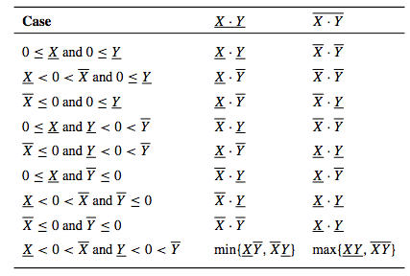
Interval Dependency
Interval dependency is the overestimation of the computation of a bound.
Occurs when interval variables appear more than once in an interval expression.
Major consideration when designing algorithms with intervals.
Cannot simply replace floating point computations with intervals.
Interval multiplication:
Notes:
The overestimation when we compute a bound on the range of X^2 as X · X is due to the phenomenon of interval dependency. Namely, if we assume x is an unknown number known to lie in the interval X, then, when we form the product x ·x, the x in the second factor, although known only to lie in X must be the same as the x in the first factor, whereas, in the definition of the interval product X ·X, it is assumed that the values in the first factor and the values in the second factor vary independently.

Slide 29
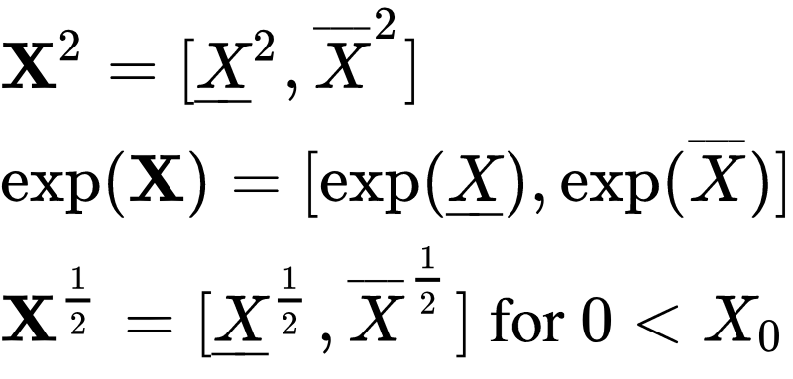
Interval Dependency - Monotonic Functions
Choose functions that are monotonic so that we can compute tight bounds.
Interval multiplication:
Notes:
The overestimation when we compute a bound on the range of X^2 as X · X is due to the phenomenon of interval dependency. Namely, if we assume x is an unknown number known to lie in the interval X, then, when we form the product x ·x, the x in the second factor, although known only to lie in X must be the same as the x in the first factor, whereas, in the definition of the interval product X ·X, it is assumed that the values in the first factor and the values in the second factor vary independently.

Slide 30
Interval Lipschitzness
Interval functions are Lipschitz continuous if they are united extensions of a real-valued function.
Examples:
Choosing a real-valued Lipschitz function guarantees a Lipchitz interval function!
Notes:
If a real valued function f(x) satisties an ordinary Lipschitz condition in X0,
|f(x) - f(y) | <= L |x-y| for x,y in X_0,
Then the united extension of f is a Lipschitz interval extension in X0.
Proof: the function f is necessarily continuous. The interval (or interval vector) X0 is compact. , Thus, w(f (X)) = |f (x1) − f (x2)| for some x1, x2 ∈ X ⊆ X0. But |x1 − x2| ≤ w(X); therefore, w(f (X)) ≤ Lw(X) for X ⊆ X0.

Slide 31
Important Property: Isotonic Inclusion of Interval Functions
Isotonic inclusion guarantees that an interval extension function F contains the exact upper and lower bounds of a real-valued function f.
Guaranteed bounds but still need to reduce interval dependency.

Slide 32
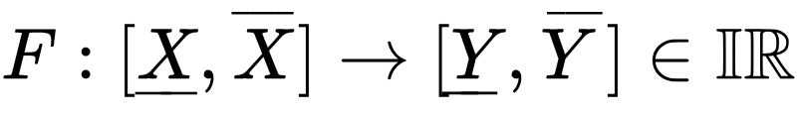
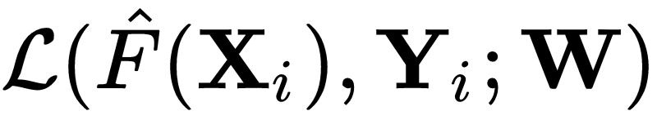
DINN
DINN is a predictive model F in regression setting:
NP-hard for intervals.
To fit (train) the DINN:
Need a training dataset with n examples.
Each example has d dimensionality
Learning of function Y by minimizing a loss (error) function
Mean Square Error for regression (monotonic!)

Slide 33
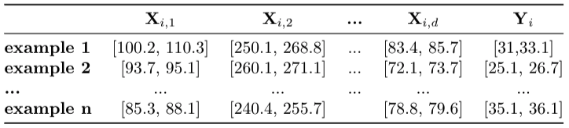
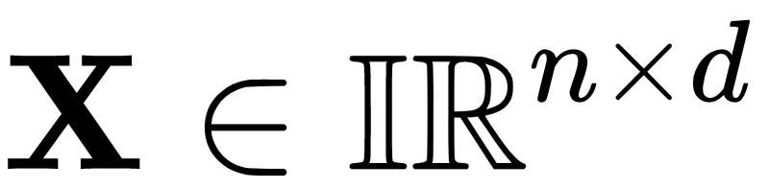
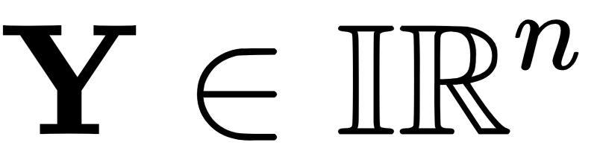
DINN: training set
Features
Targets

Slide 34
DINN Training
Steps for training the network:
Compute the loss at each training epoch via forward propagation.
Compute the gradient of the loss w.r.t. The model parameters W via Backpropagation.
Minimize the loss function via mini batch stochastic gradient descent.

Slide 35
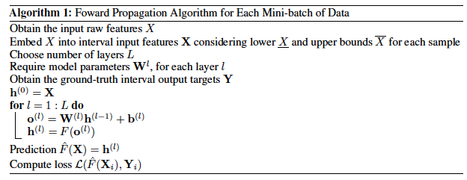
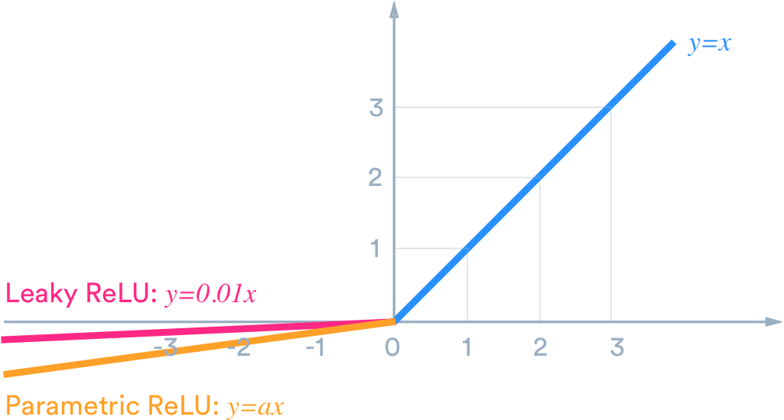
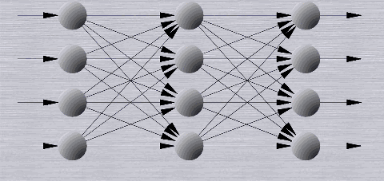
Forward Propagation Algorithm
F = ReLU = max(o^{(l)},0)

Slide 36
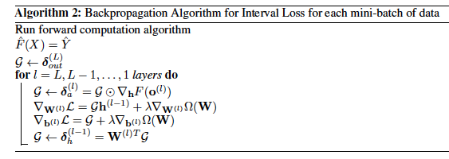
Backpropagation Algorithm

Slide 37
Mini-batch SGD
Optimization is done via stochastic gradient descent
Update rule:

Slide 38
Regularization
Prevents overfitting
Stabilizes solution
Very important for intervals
Currently using L1 and L2 regularization

Slide 39
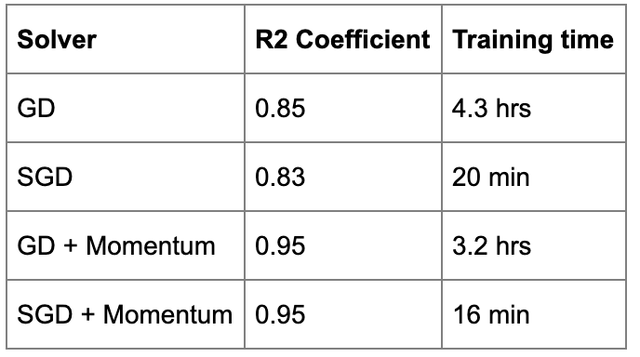
Experiments: UCI Concrete Dataset
Network Hyperparameters:
Hidden Dimensions: H1 = 128, H2 = 64, H3 = 16.
Mini-batch size = 10
Learning Rate = 0.005
L2 regularization.
Features: 8 chemical/physical measurements.
Targets: Concrete Strength.

Slide 40
Experiments: UCI Concrete Dataset
Input uncertainty: input x 10e-3 radius
Predicted uncertainty:
Mean upper bound: 20% of target
Mean lower bound: 15% of target

Slide 41
Future work
Structural Health Monitoring data
Forward problem
Inverse problem
Deep Interval Recurrent Neural Network with LSTM units
For sequences of data involving long-term dependencies.
Different regularization methods
Dropout
Decision-making under uncertainty for autonomous systems:
Reinforcement Learning

Slide 42
Thank you!
Twitter: @davidbtncourt

